Slide 1
Research Design and Analysis: Statistical Inference for Correlation and Regression
Keith Lohse, PhD, PStat
Department of Health and Kinesiology
Department of Physical Therapy and Athletic Training
University of Utah
e: rehabinformatics@gmail.com

Slide 2
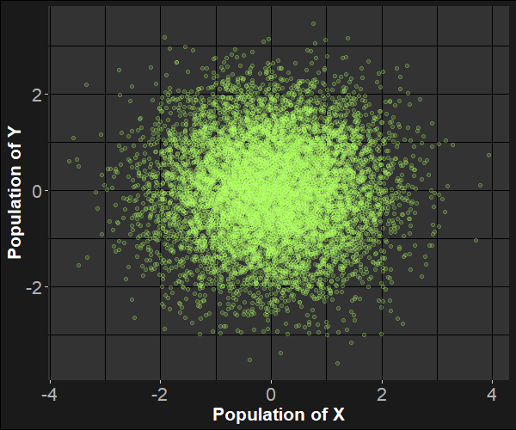

Population of Two Unrelated Variables
In our population, there is no correlation between Y and X.
$ρ=0$
This looks like a p, but it’s the Greek letter rho.

Slide 3
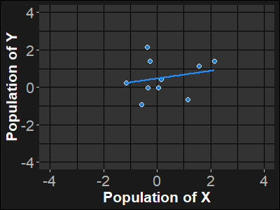
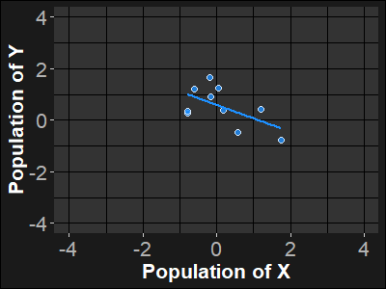
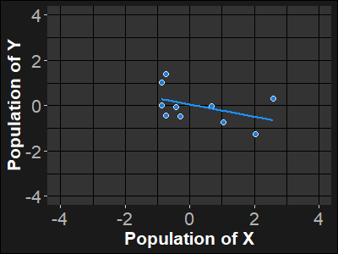
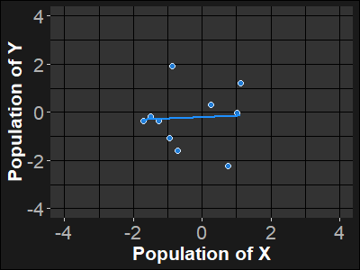
Sampling from the Population:
Taking samples of N=10

Slide 4
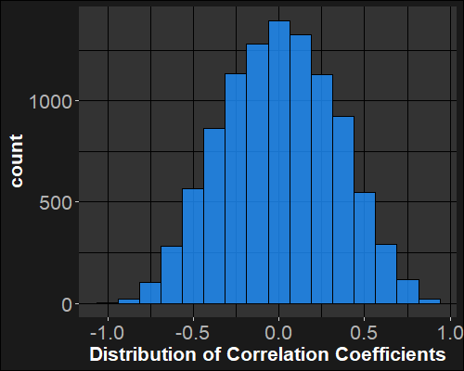
Distribution of Sample Correlations:
Take samples of N=10:
Look at the correlation coefficient in each of our 10,000 samples:
…

Slide 5
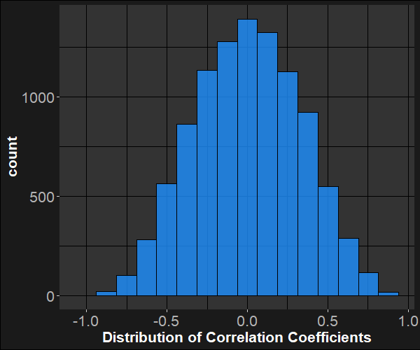
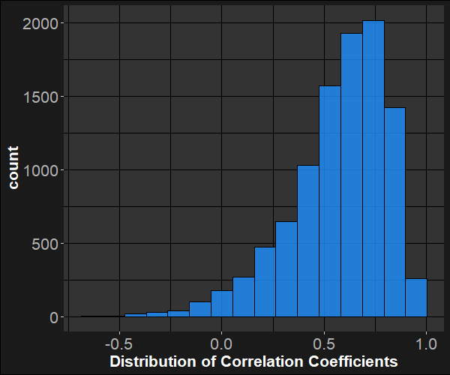



But it get’s a little complicated…
When $ρ=0$, the distribution is approximately normal, however, when $ρ=0$.6, you can see that the distribution is negatively skewed.
If $ρ<0$, then the distribution would have positive skew.
$$ρ=0$$
$$ρ=0.6$$

Slide 6
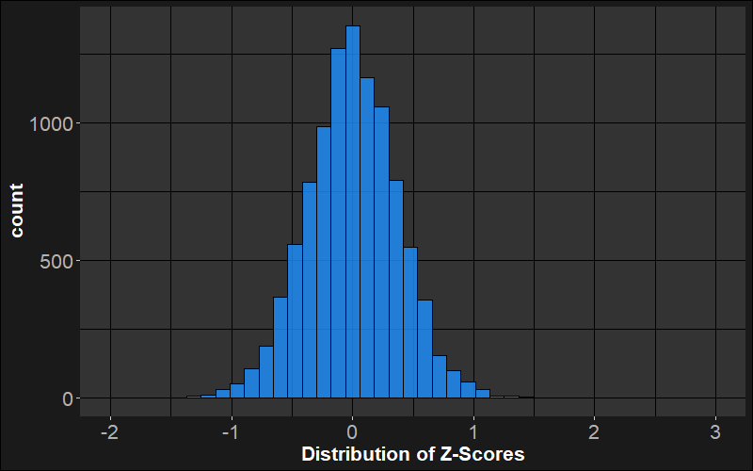
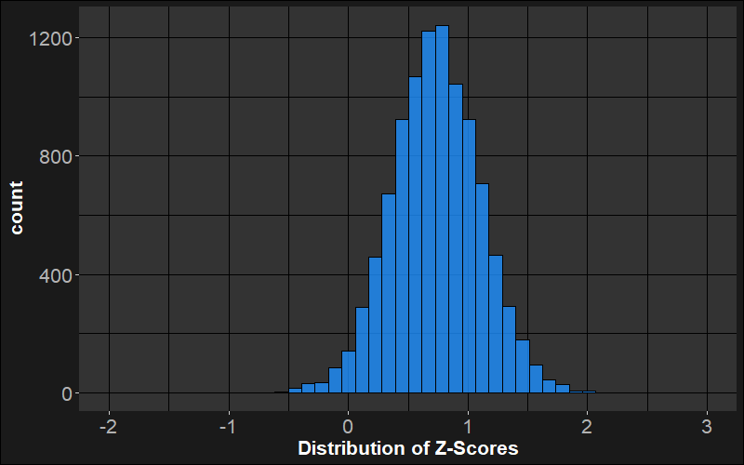

Fisher’s z-Transformation
To get around this issue of skew, we can transform the r-values into z-values to make sure they follow a normal distribution.
$$z=\frac{1}{2}ln⁡(\frac{1+r}{1−r})$$

Slide 7
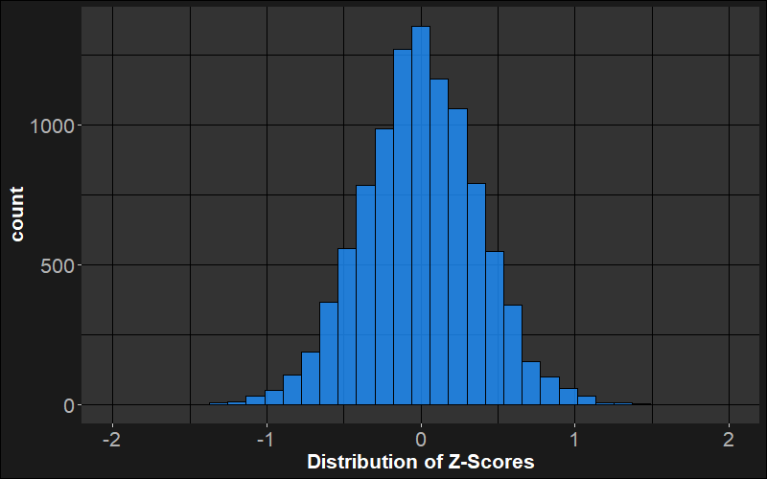

Null Hypothesis Test for Pearson’s r
By always doing the z-transform, we’ll have a normal sampling distribution regardless of the underlying correlation.
If $ρ=0$ then ($z=0$).
And the distribution has a SE of :
$$σ_{z}=\frac{1}{\sqrt{N−3}}$$
(We wont get into the derivation of that SE here, but you can prove it to yourself with simulations in R!)

Slide 8

Null Hypothesis Test for Pearson’s r
Under the null hypothesis, we assume
$H_{0}: ρ=0$ ($z=0$)
With the alternative hypothesis
$H_{a}: ρ≠0$ ($z≠0$)

Slide 9
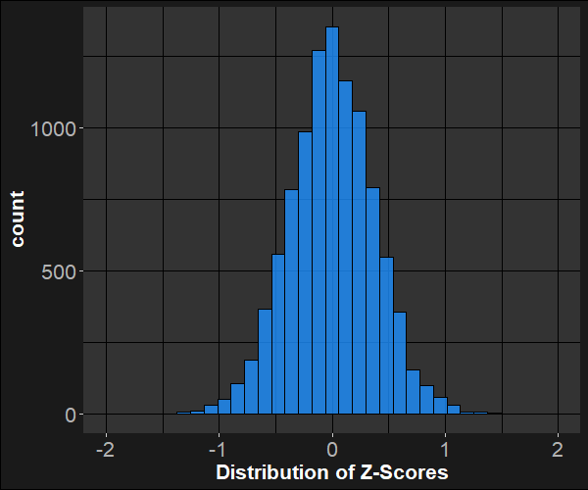

Null Hypothesis Test for Pearson’s r
Under the null hypothesis, we assume
$H_{0}: ρ=0$ ($z=0$)
With the alternative hypothesis
$H_{a}: ρ≠0$ ($z≠0$)
Following the z-transform, we know what the sample distribution looks like and we can separate the middle 95% from the extreme 5%.

Slide 10
Null Hypothesis Test for Pearson’s r
If the observed correlation (z-transformed) falls outside this range, we would reject the null hypothesis (p<α).
Rejecting the null hypothesis means we think the true correlation coefficient is unlikely to be zero.
(Assuming all of our other assumptions are true.)
But remember this is probabilistic statement, we still have a false positive risk!

Slide 11
Inference in Regression

Slide 12
Inference in Regression
In a regression, we have exactly the same logic for our hypothesis tests. The main difference is that now we can conduct a hypothesis test for both the intercept and the slope.
If we did this with standard normal variables, the results would be the same as the correlations we just did (see previous lectures).
Instead, let’s pick two variables two variables that should be unrelated, but have meaningful values:
Adult Height: M = 1.70 m, sd = 0.11 m
Adult IQ: M = 100, sd = 15

Slide 13
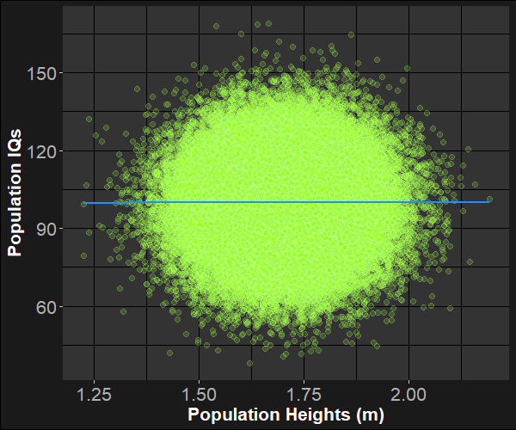
Inference in Regression
Adult Height: M = 1.70 m, sd = 0.11 m
Adult IQ: M = 100, sd = 15
As before, we can repeatedly sample from this population to simulate the sampling distribution of slopes and intercepts.

Slide 14
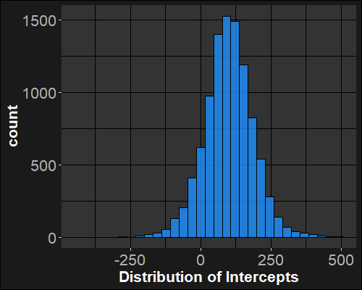
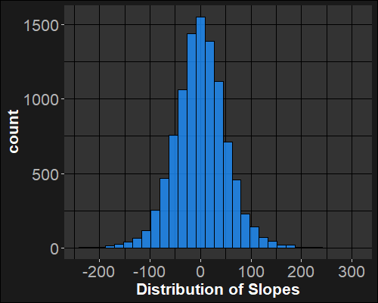
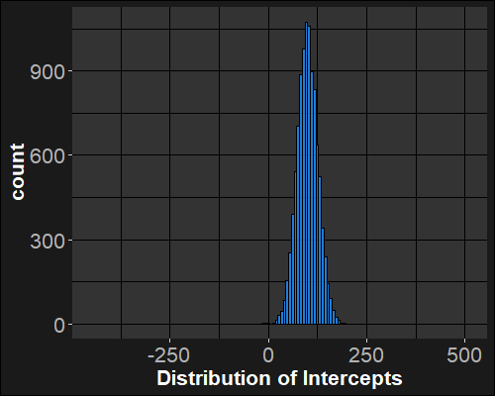
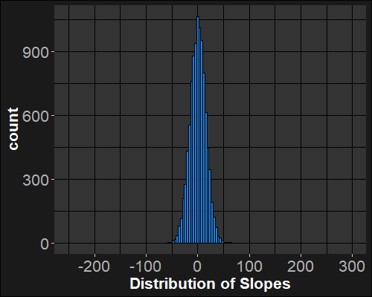

Sampling Distributions
Intercepts
Slopes
$$IQ_{i}=β_{0}+β_{1}\left(HT_{i}\right)+ε_{i}$$
N=10
M = 100, sd = 15
N=80
M = 1.70 m, sd = 0.11 m

Slide 15



Hypothesis Tests: Slope and intercept
In our regression, we are estimating two parameters. Thus, we have hypotheses for each:
Intercept:
H0: β₀ = 0
H1: β₀ ≠ 0
Slope:
H0: β₁ = 0
H1: β₁ ≠ 0
$${SE}_{β_{0}}={SE}_{β1}\sqrt{\frac{\sum{x^{2}}}{N}}$$
$$t_{obs}=\frac{\hat{β}−β_{H0}}{SE_{β}}=\frac{b−0}{SE_{b}}$$
$${SE}_{β1}=\frac{(\sqrt{\frac{\sum{{\left(y_{i}−\hat{y}\right)}^{2}}}{N−2}})}{\sqrt{\sum{{\left(x_{i}−\overline{x}\right)}^{2}}}}$$

Slide 16

Hypothesis Tests: Slope and intercept
In our regression, we are estimating two parameters. Thus, we have hypotheses for each:
Intercept:
H0: β₀ = 0
H1: β₀ ≠ 0
Slope:
H0: β₁ = 0
H1: β₁ ≠ 0
$$t_{obs}=\frac{\hat{β}−β_{H0}}{SE_{β}}=\frac{b−0}{SE_{b}}=\frac{Effect Size}{Variability}$$
N=10
N=80

